Slide 1

ECE 606: Solid State Devices I
Fall 2026
Peide (Peter) Ye
Richard J. and Mary Jo Schwartz Professor
Elmore Family School of Electrical and Computer Engineering, Purdue University
yep@purdue.edu
https://engineering.purdue.edu/~yep/courses.htm
Elmore School of Electrical and Computer Engineering
8/12/2026

Slide 2
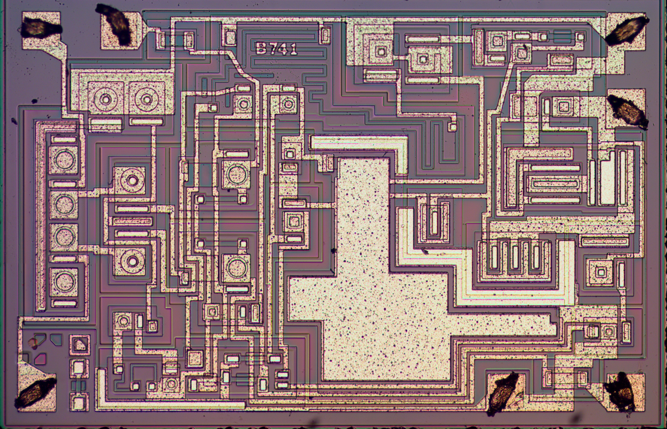
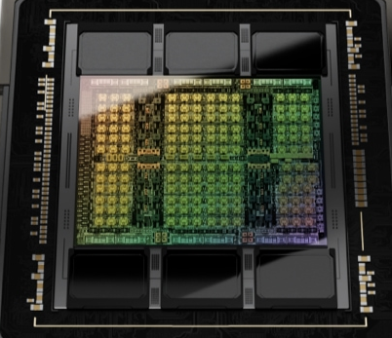
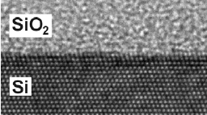
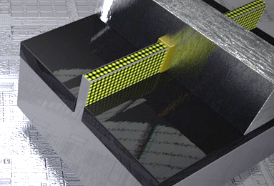
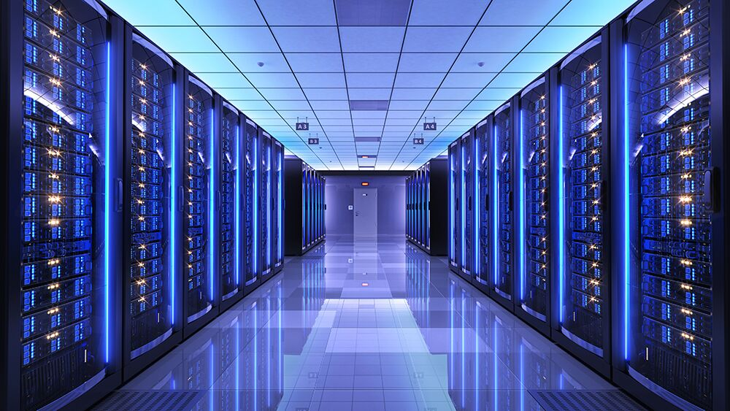

Why Are Solid-State Devices Interesting?
A scientific and engineering masterpiece in human history
Crystal
Transistor
Circuit
SOC
Data center
Atom
Nano
Micro
Centimeter
Kilometer
Scale
The technology begins with solid-state physics and device principles.
Notes:
Why interesting
Many reasons
Scientific and engineering masterpiece
Start with…
Making such a complicated system work across this huge landscape is amazing, a masterpiece. Involves in a lot of science understanding, discovery and engineering innovations.
To make everything work as expected, must understand at very fundamental level. That is…

Slide 3
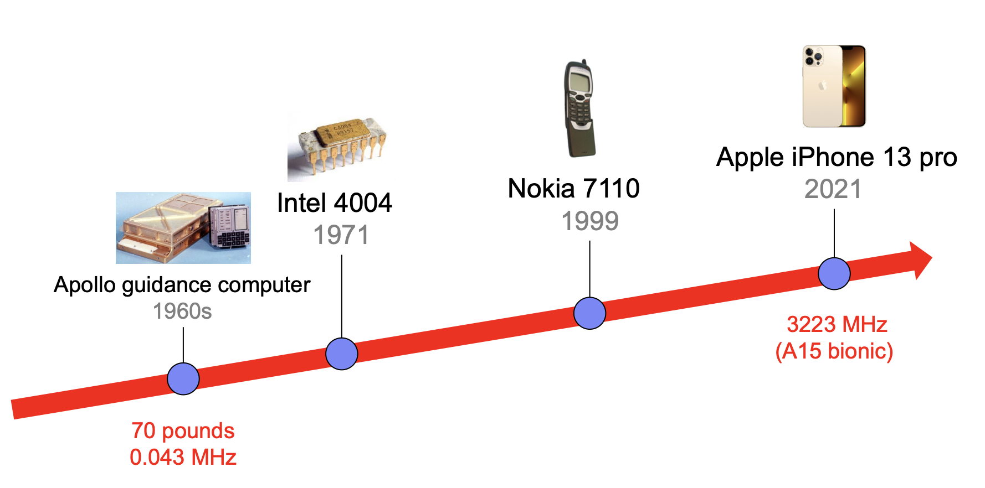
Semiconductor Evolution in 50 Years
187 gram
Notes:
First silicon integrated circuits used in practice – Apollo Guidance Computer, a digital computer used by NASA for navigating spacecraft to the moon and back.
Weight and speed.
Today.

Slide 4
# Transistors per Chip Doubles Every Two Years
Not a physics law, but an engineering challenge
– physics, chemistry, engineering, manufacturing techniques, …
Notes:
Roman is not built in one day.
Driver: Moore’s law.
4 or 5 data points -> ex’trapolagte for several decades
Not a physics law, but an engineering challenge – what physics and chemistry do we need to understand and what manufacturing techniques do we need to improve or invent?

Slide 5
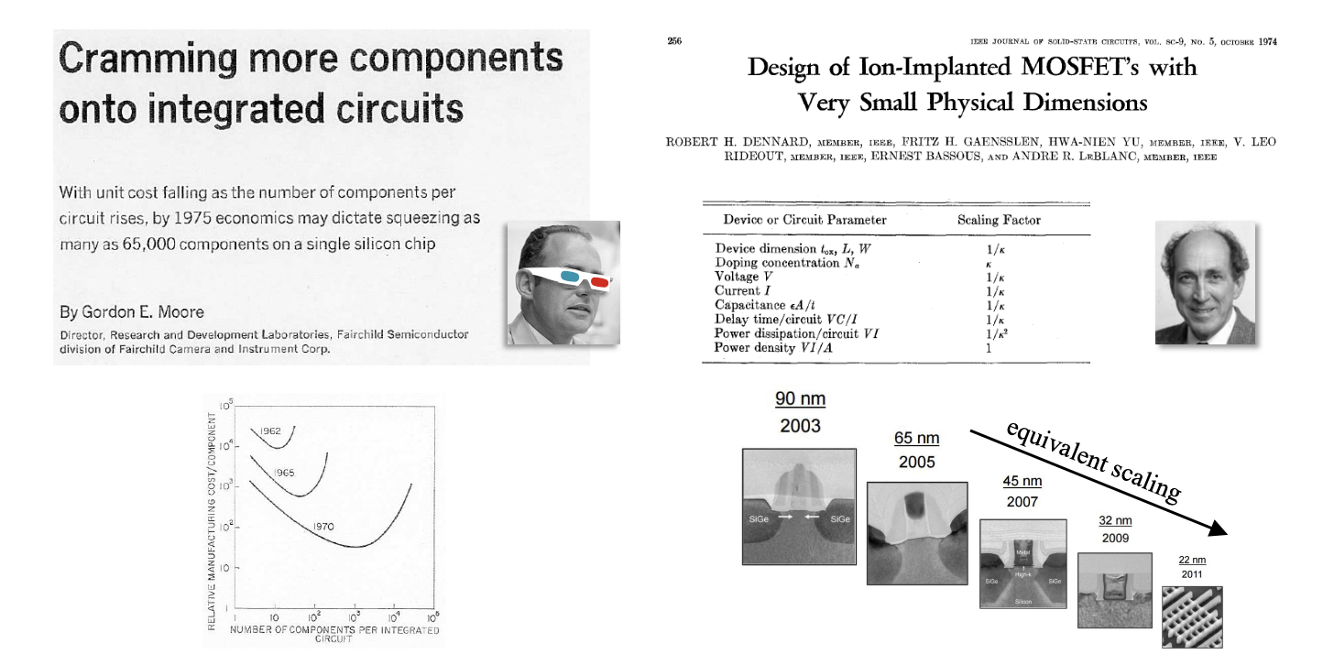
Moore’s Law vs. Dennard’s Law
Dimension
t_{OX}, L, W ∝ 1/κ
V ∝ 1/κ
Speed
f ∝ κ
Power efficiency
CV²f ∝ 1/κ²
Economic argument
Physics argument:
Smaller –> faster & better efficiency
Notes:
Moore Law: economic argument.
As scientists and engineers, care about physics.
Dennard discovered and laid out the underlying physics that motivate us to make transistors smaller and smaller. It says…
So now story is finally completed. We set up an engineering challenge, which is making transistors smaller every year, if we pull it off, we will have more powerful chips. By more powerful, we mean faster and more efficient.

Slide 6
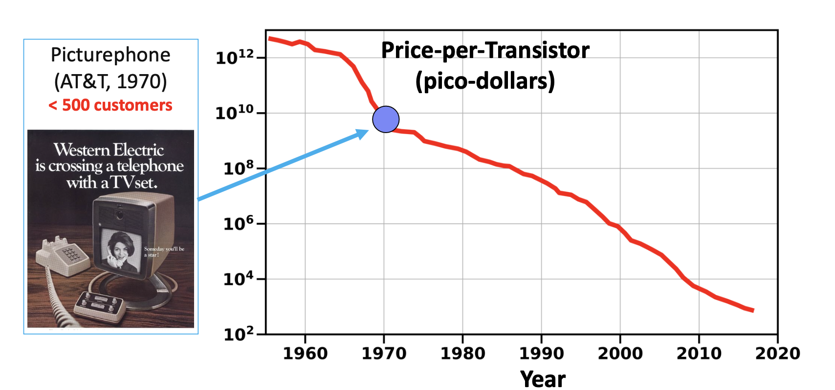
From Cost to Ubiquity: The Economics of Transistors
Notes:
Natural follow-up question: cost.
Cost per transistor stays the same, out of game. The truth is the opposite…
Every year, we can have more powerful chips, yet lower cost. So we can deploy this wonderful technology everywhere, e.g., -> ubiquitous -> profound impact on society.

Slide 7
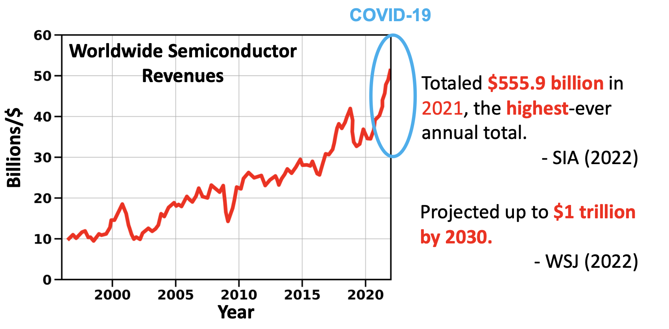
From Ubiquity to Value: Worldwide Economic Impact
Notes:
Therefore, if we take a look at the worldwide semiconductor revenues, it has been increasing remarkably. Projected to hit 1 trillion by 2030.
Semiconductor is one of the most important fields for the country and the world.

Slide 8
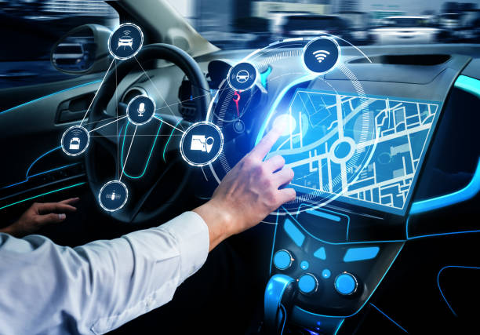
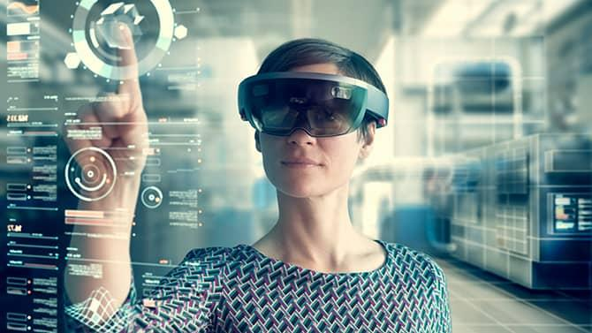
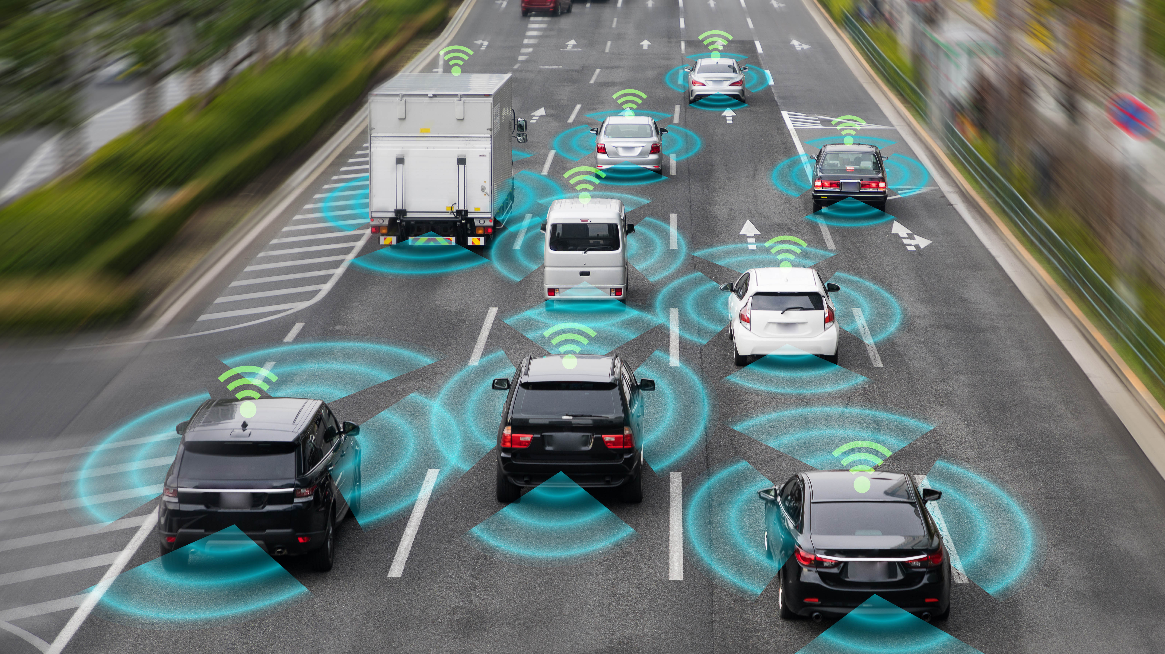
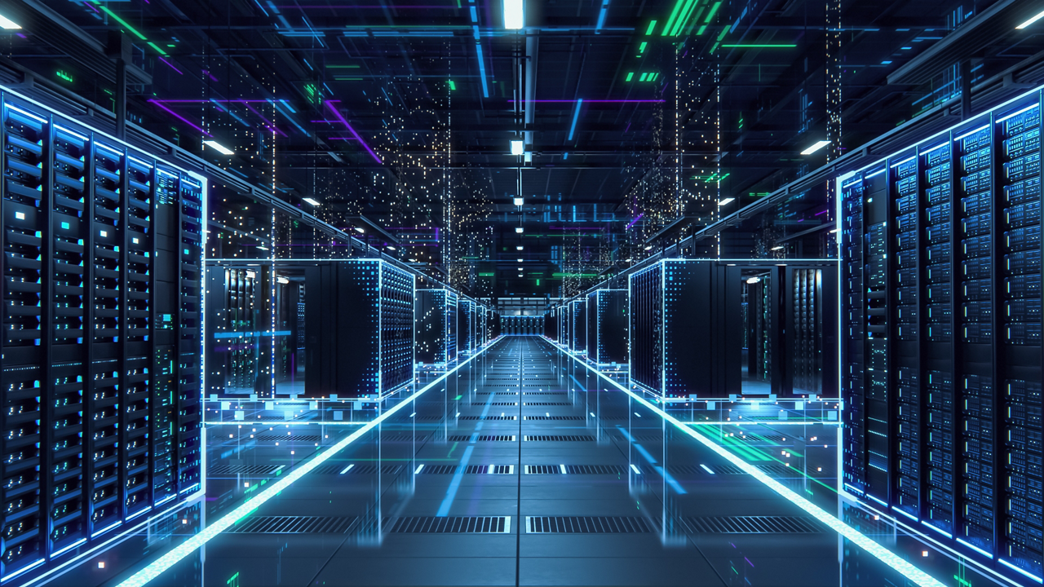

Future Relies on Semiconductor
Electric vehicle
VR/AR
Autonomous driving
Semiconductor
AI data center
Wearable
Notes:
Even more importantly, our future relies on semiconductors.
Semiconductor is the foundation and engine of all these emerging technologies.

Slide 9
Everything Above Begins w/ Solid-State Physics & Devices
Crystal
Transistor
Circuit
SOC
Data center
Atom
Nano
Micro
Centimeter
Kilometer
Scale
Objectives of this course:
Explain the working principles of these devices
Relate the device performance to materials and design criteria
Speak the “language” of device engineers
Be ready to engage in device research & industrial engineering
Notes:
Semiconductor works through atoms to data centers.
Solid-state physics and devices fundamental.

Slide 10
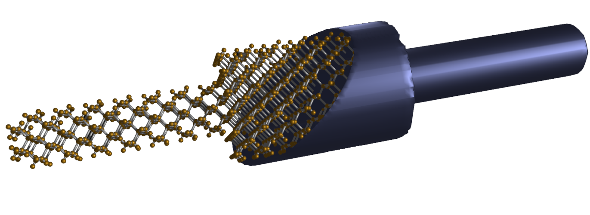
Course Structure Rationale
I
I = G ^{x} V
= q ^{x} n ^{x} v ^{x} A
V
charge
density
velocity
area
Materials, composition, crystals
Tabulated for “known” bulk materials
At nm-scale properties change with geometry => theory
Quantum Mechanics + Equilibrium Statistical Mechanics
Concepts of effective masses and occupation factors
Week 1-5
Transport with scattering, non-equilibrium Statistical Mechanics
Drift-diffusion equation with recombination-generation
Week 5-7
Understanding transport in concrete devices
Diodes, BJT/HBT, MOS
Week 8-16

Slide 11
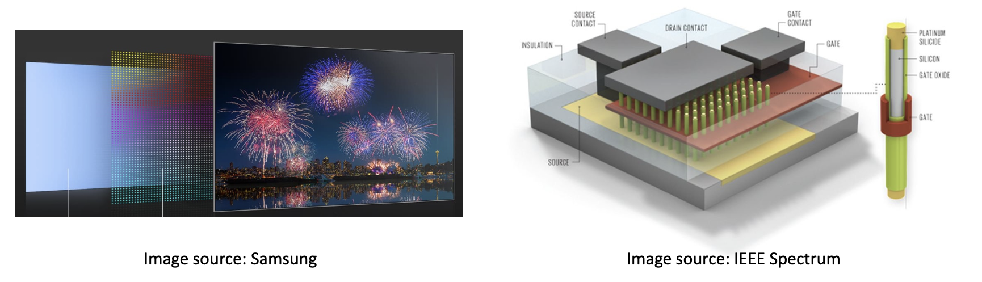
Course Projects
Project 1: Quantum dots
Project 2: Nanowire transistors

Slide 12

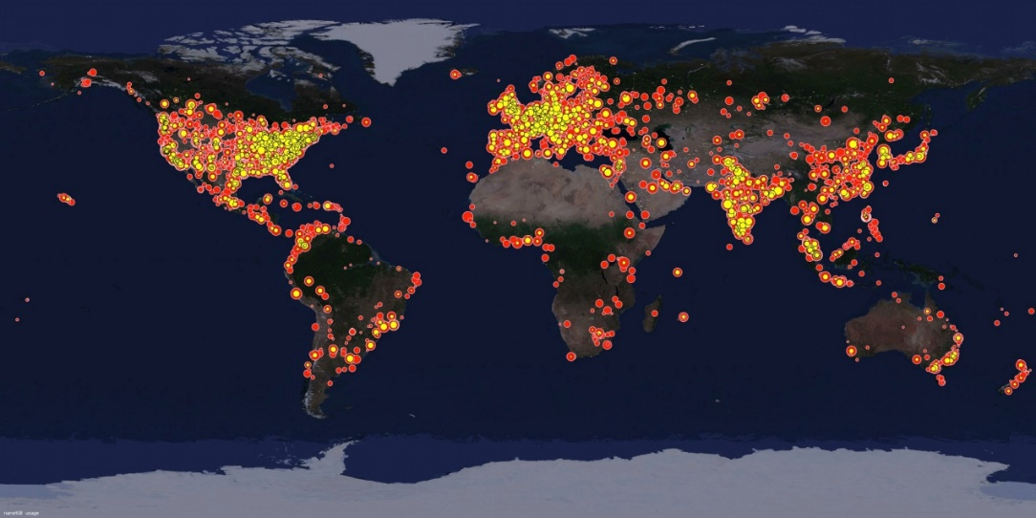
Your Content Contributors
Prof. Muhammad Ashraful Alam
  Created the first sequence of the course slides
  2009 version of the course at nanoHUB
  https://nanohub.org/resources/5749
Dr. Parijat Sengupta
  Intel Corporation
  Helped with assignments
Gerhard Klimeck
  Prof. at Purdue since Dec. 2003
  Principal at NASA/JPL, 6 years
  Texas Instruments, 4 years
  Purdue Graduate (1994)
  Over 500 papers on devices/physics
  2012 version of the course at nanoHUB https://nanohub.org/resources/15070

Slide 13
Course Information & Logistics
Course website: Brightspace. Login required.
Instructional modality: flipped-classroom
Online video lectures + in-person recitations (in-class on MWF + optional online TBD)
Textbooks: (hardcopies @WALC’s library of engineering and science; PDFs @ Brightspace)
ASF: Advanced Semiconductor Fundamentals (quantum, semiconductor, transport)
SDF: Semiconductor Device Fundamentals (diode, bipolar, MOSFET)
Homework/Project
8 homework – due on Lecture Time
One project starting on 5th week: team of 3 students – team formation due 9/18 (email TA)
Exam: One mid-term exam on 8th week; one final exam on 15th or 16th week
Office hour: On zoom or in-person @TBD; additional appointments scheduled by email
TA: Hong-Yang Lin (xxx@purdue.edu)
Notes:
Hybrid mode called flipped-classroom. New teaching approach designed to enhance interaction & engagement. Statistically more effective learning and better outcome in terms of grade.
Online video + three recitations: first 2 vs. Friday - question-driven, ask anything relevant.
Expectation: watch & somewhat understanding + recitations create an active-learning environment to help digest concepts and materials better.

Slide 14
Final Grade Breakdown
Homework | 20%
Project | 20%
Mid-term Exam | 30%
Final Exam | 30%

Slide 15
Starting Now
Go over and get familiar with syllabus
Watch sections 1-3 lecture videos
Set up Gradescope, Brightspace, Piazza, and nanoHUB
Get started on homework
Get to know your classmates

